Slide 1

Prediction models using Linear Regression
Post Graduate Certification in Data Science
Applied Econometrics – assignment #1
Prediction of Bollywood Movie Earnings
Sadanand Manekar
Sonali Nimkar
Powered by
November 2015

Slide 2
Contents
Problem Statement
Solution Approach
The Solution
Points to ponder …
Going forward …
Appendix

Slide 3
Problem Statement
Bollywood is the largest movie making entity on the planet, with an average annual turn over of about USD 3 billion / INR 1200 crore
This industry warrants the use of sophisticated analytics methods to lend a measure of scientific discipline to the art of film making
This necessitates gaining an understanding of factors that drive or impact the earning capability of movies
We propose to use currently available historical data around the revenue financials and related characteristics of the movies to create statistical models
Earnings data and other statistics have been made available for a number of Bollywood movies released in calendar years 2014 and 2015
Using this data, and the method of linear regression, models will be created and tested

Slide 4
Solution Approach

Slide 5
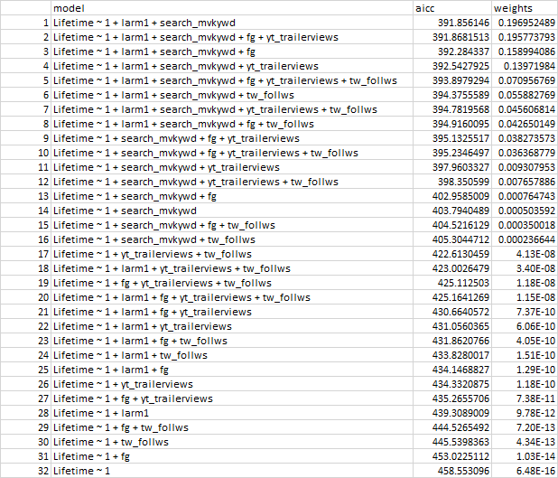
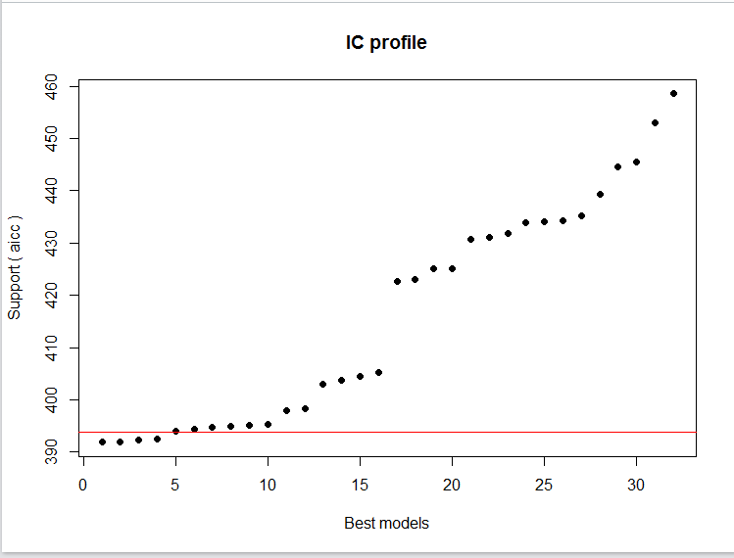
The Solution

Slide 6
Points to ponder …

Slide 7
Going forward …

Slide 8
Appendix
Package glmulti

Slide 9
Thank you!

Slide 12
Going forward…
sdddfdfdfd

